Slide 1
Selenium webdriver
By
Kirubanand ramasamy

Slide 2
Step 1: Install Java on your computer
Download and install the Java Software Development Kit (JDK). You download the JDK file from this location:
http://www.oracle.com/technetwork/java/javase/downloads/index.html
Note: This JDK version comes bundled with Java Runtime Environment (i.e. JRE) so we don't need to install the JRE separately.
download eclipse-http://www.eclipse.org/downloads/packages/release/kepler/sr1

Slide 3
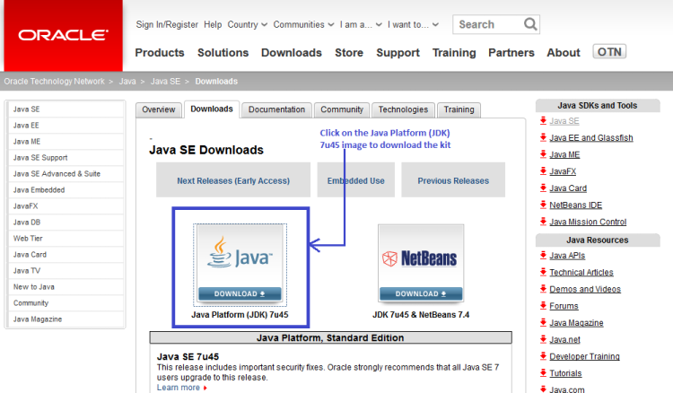

Slide 4
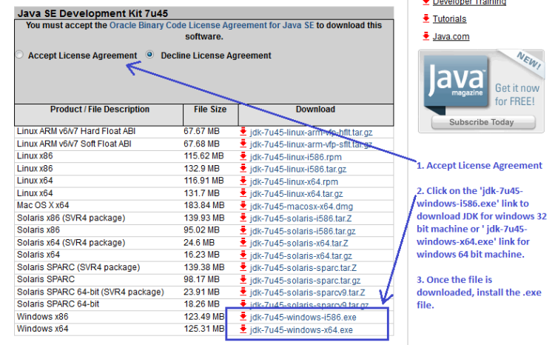

Slide 5
Step 2: Install Eclipses IDE
Now download “Eclipse IDE for Java EE Developers”. You can download eclipses from this location: http://www.eclipse.org/downloads/.
Make sure to choose correct link for downloading eclipses which corresponds to your OS i.e. for Windows 32 Bit and 64 Bit versions. You should be able to download a ZIP file named “eclipse-java-kepler-SR1-win32-x86_64.zip”.

Slide 6
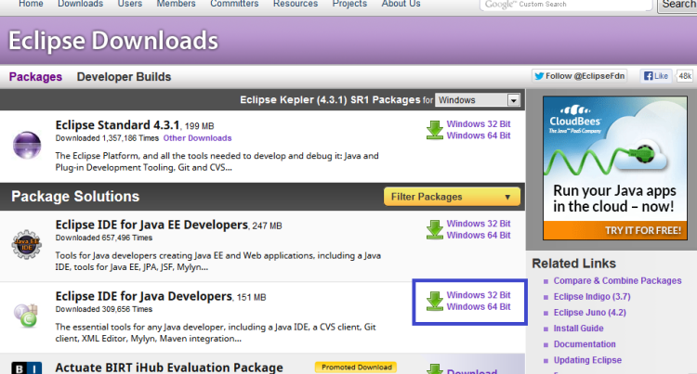

Slide 7
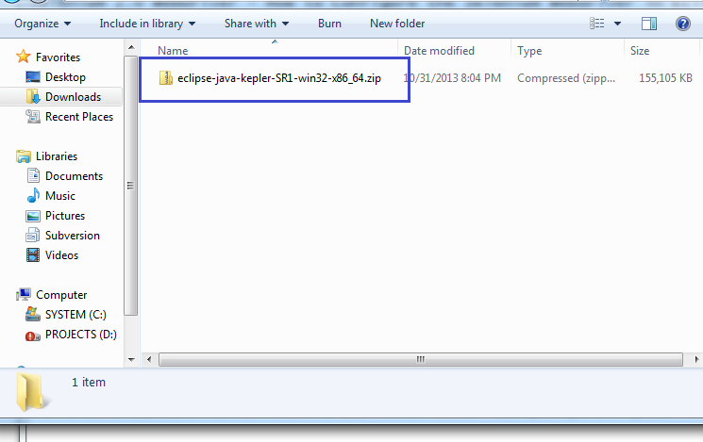
Inside the ZIP file, there is an “eclipse” folder which contains all the application files. So we can extract the “eclipse” folder anywhere in your PC. Let say we want to extract it to C drive.

Slide 8
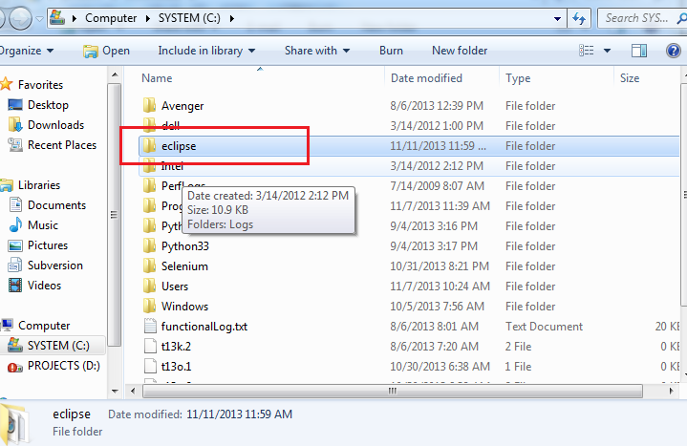

Slide 9
Step 3 – Download the Selenium Java Client Driver
You can download the Selenium Java Client Driver from this location:http://docs.seleniumhq.org/download/
Click on Download link which is associated with java release. Download the jar files. You will find client drivers for other languages there, but only choose the one for Java as shown above in the screenshot.
After downloading you will get a folder which should contain two jar files related to selenium, a lib folder which also contains jar files inside it. Beside this, there is a change log file as well. Refer to the screenshot below.

Slide 10
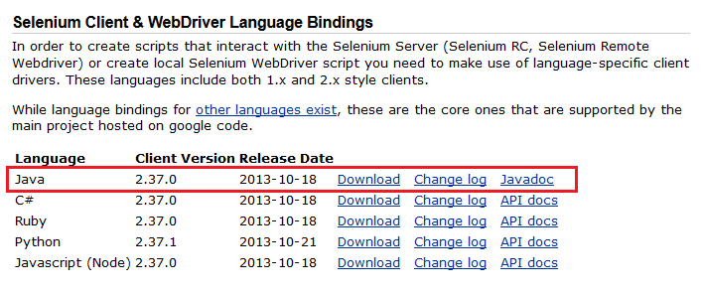

Slide 11
Step 4: Create a New project in Eclipse
Navigate to C drive and open eclipse folder where we have extacted all the application files related to eclipse. In Eclipse folder you would find a 'eclipse.exe' file. Now click on the .exe file.
This would ask you to select a workspace, you may accept the default location or simply create a new workspace inside C drive and confirm OK.
Now in Eclipse create a new project and for creating click on File menu –> New –> Java Project -> Name the project as “testproject” and click finish.
Create a new Java class, for doing this again click on File menu –> New -> Class then name it as “testclass” and select the checkbox for 'public static void main (String[] args) and click finish.

Slide 12
Step 4: Create a New project in Eclipse
On clicking 'Finish' in 'Java Class' wizard, your Eclipse IDE should look like the image below.
Now Right-click on testproject and select Properties. On the Properties window, click on “Java Build Path”. Click on the Libraries tab, and then click “Add External JARs..”
Navigate to C:\selenium-2.37.0\ (or any other location where you saved the extracted contents of “selenium-2.37.0.zip” in step 3).
Add all the JAR files inside and outside the “libs” folder. Your Properties window after adding all the jar file should now look similar to the image below.
Finally, click OK and we have completed importing Selenium libraries into our project.

Slide 13
Step 5: Time to Code!!
Now it’s time to write some code. For this, let use the wikipedia site to create a sample script for test execution.
http://www.softwaretestingclub.com/profiles/blogs/selenium-2-0-webdriver-how-to-configure-selenium-webdriver-in

